Slide 1




G.H. RAISONI COLLEGE OF ENGINEERING
AND MANAGEMENT, WAGHOLI, PUNE.
Department of AI & AIML
E-COMMERCE Product Review
Guide: Amitkumar Shinde
Name of Projectees
Shruti Sonaje (B-39) Surabhi Tupe(B-44)
Arpita Udhe(B-46)

Slide 2
Contents
Introduction
Justifications for Selecting the Title
Problem Statement
Literature Survey
Block Diagram
Expected Result
Methodologies

Slide 3
Introduction
When companies want to understand public opinion, performing sentiment analysis helps
them recognize what customers like about their products. It also helps to figure out the
primary issues with their products.Reviewing product using sentiment analysis is becoming popular for text mining. Research is also considering research in area of computational linguistics. Research work is focusing correlation among Amazon product reviews.
Research is also considering rating of products provided by customers.Reserach has considered traditional machine learning algorithms along with Naive Bayes analysis,SVM,Knearest neighbor mechanism. Research has also considered deep neural networks along with Recurrent Neural Network (RNN). Research is supposed to provide better solution for sentimental analysis.

Slide 4
Justification For Selecting The Title
The choice of the title "E-commerce Product Review" for our minor project is driven by several compelling reasons.
Real-World Application: E-commerce product reviews are an integral part of online shopping experiences. By working on this project, you will gain hands-on experience in a domain with direct real-world relevance. This experience can be a valuable addition to your portfolio or resume.
Market Demand: E-commerce is a rapidly growing industry, and customer reviews play a crucial role in influencing purchasing decisions. Developing a product review system can address the market demand for platforms that facilitate customer feedback.
Enhancing User Experience: A well-designed product review system can enhance the user experience on e-commerce websites. By focusing on usability and functionality, you can contribute to making online shopping more enjoyable and efficient for customers.
Data Analysis Skills: Analyzing and processing large volumes of product review data can help you develop data analysis skills. You can learn how to extract valuable insights from user-generated content, such as sentiment analysis, trends, and customer preferences.

Slide 5
Problem Statement
Design a system for analyzing Amazon product reviews to provide valuable insights to both customers and sellers. The goal is to develop a platform that can process and evaluate large volumes of reviews to extract meaningful information, identify trends, and enhance the overall shopping experience.

Slide 6
Literature Survey
Sr. No. | Paper Title and its Author/year | Details of Publication | Methodology
1 | R.Collobert/2011 | To implement NLP from scratch. | machine Learning
2 | K.Dave/2003 | Performing Opinion extraction and sementic classification of product review | Sementic classificatin
3 | M.S Eilli | To purpose amzon reviews,with sentimental analysis | Analyzing the Sentiment
4 | C.rain./2013 | Implement Sentimental Analysis in amzon product review | Machine Learning
6

Slide 7
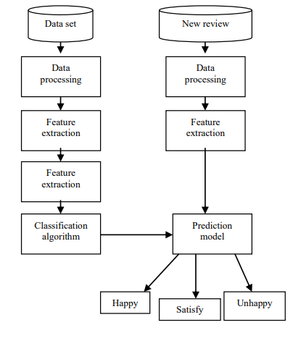
Block Diagram

Slide 8
Methodologies
Naive Bayes:
Naïve Bayes algorithm is a supervised learning algorithm, which is based on Bayes theorem and used for solving classification problems.It is mainly used in text classification that
includes a high-dimensional training dataset.Naïve Bayes Classifier is one of the simple and most effective Classification algorithms which helps in building the fast machine learning models that can make quick predictions.It is a probabilistic classifier, which means it predicts on the basis of the probability of an object.Some popular examples of Naïve Bayes Algorithm are spam filtration, Sentimental analysis, and classifying articles.
K-nearest Neighbor:
K-NN algorithm assumes the similarity between the new case/data and available cases and put the new case into the category that is most similar to the available categories.
It is also called a lazy learner algorithm because it does not learn from the training set immediately instead it stores the dataset and at the time of classification, it performs an action on the dataset.Example: Suppose, we have an image of a creature that looks similar to cat and dog, but we want to know either it is a cat or dog. So for this identification, we can use the KNN algorithm, as it works on a similarity measure. Our KNN model will find the similar features of the new data set to the cats and dogs images and based on the most similar features it will put it in either cat or dog category.
Linear Support Vector Machine:
Support Vector Machine or SVM is one of the most popular Supervised Learning algorithms, which is used for Classification as well as Regression problems. However, primarily, it is used for Classification problems in Machine Learning.
The goal of the SVM algorithm is to create the best line or decision boundary that can segregate n-dimensional space into classes so that we can easily put the new data point in the correct category in the future. This best decision boundary is called a hyperplane.

Slide 9
Expected Result
The expected output of the E-commerce product review project would include various components and deliverables, each designed to achieve specific goals and provide value to both customers and sellers. Here are the expected outputs:
Increased User Engagement: Implementing a product review system can lead to higher user engagement on your e-commerce platform. Users may spend more time on your website, interact with reviews, and participate in discussions.
Enhanced User Trust: Authentic and reliable product reviews can build trust among customers. Users are more likely to make informed purchasing decisions when they trust the reviews on your platform.
Improved Conversion Rates: Positive product reviews can influence potential customers to make a purchase. As more users leave positive reviews, you can expect an increase in conversion rates.
Valuable User Data: The data generated by user reviews can provide valuable insights into customer preferences, sentiments, and behavior. This data can be used for marketing, product development, and customer segmentation.
Customer Feedback Loop: A product review system allows customers to provide feedback directly to your business. You can use this feedback to make improvements to your products, services, or user experience.

Slide 10
Thank you !

